Slide 1
SUPPLY CHAIN MANAGEMENT
NANDAKISHORE.P
MILESTONE:2
The objective of this exercise is to build a model, using historical data that will determine an optimum weight of the product to be shipped each time from the respective warehouses.
In this dataset we have 24 columns.Here 8 columns are categorical and remaining are numerical. ”Product wt. in tons” is our target column. Some columns have direct relationship & some have less or no relationship with the target column. Some differences are found from Milestone:1 while analyzing the dataset through hypothetical and graphical method.
First let’s check the relation of target column to numerical columns.

Slide 2
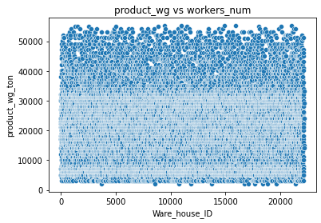
1 | 'Warehouse_ID ‘ and 'WH_Manager_ID' vs ‘Product_wg_ton‘.
H 0 | Product_wg_ton is independent on 'Warehouse_ID ‘ & 'WH_Manager_ID'
H 1 | Product_wg_ton is dependent on 'Warehouse_ID ‘ & 'WH_Manager_ID'
P value | p value is 0.922 >0.05 for wh id and also for Manager id .We accept H0 which is the null hypothesis.
From hypothetical way and also from the graph, we inferred that warehouse id and manager id is independent with product wt. Same as that of Milestone:1.

Slide 3
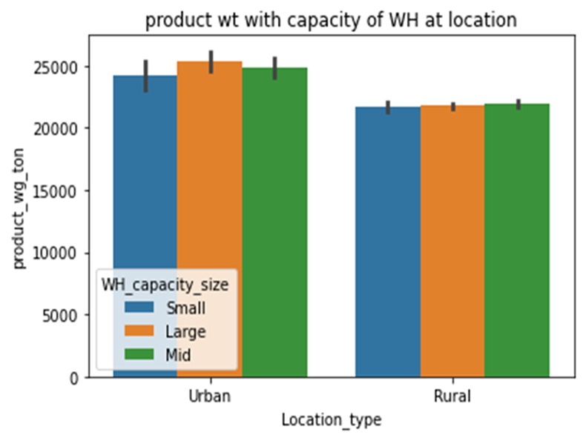
2 | Feature column: 'Location_type‘ vs Target column: ‘Product_wg_ton‘.
H0 | Product_wg_ton is independent on 'Location_type'
H1 | Product_wg_ton is dependent on 'Location_type'
P value | p value is 2.5921858097042396e-16 . We accept H1 which is the alternate hypothesis.
Here capacity of warehouse and location are plotted together. From graph as well as from hypothesis ,production wt is more at urban area and also capacity of warehouse . This is because our product has more customers in urban and these 2 columns can affect the target column, as suggested in Milestone 1.

Slide 4
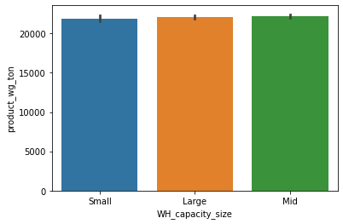
3 | Feature column: 'WH_capacity_size‘ vs Target column: ‘Product_wg_ton‘.
H0 | Product_wg_ton is independent on 'WH_capacity_size'
H1 | Product_wg_ton is dependent on 'WH_capacity_size'
P value | p value is 0.882 . We accept H0 which is the null hypothesis.
From hypothesis product wt is independent of wh capacity and also we got the the same inferences from the graph.M1 suggests both columns are dependent.

Slide 5
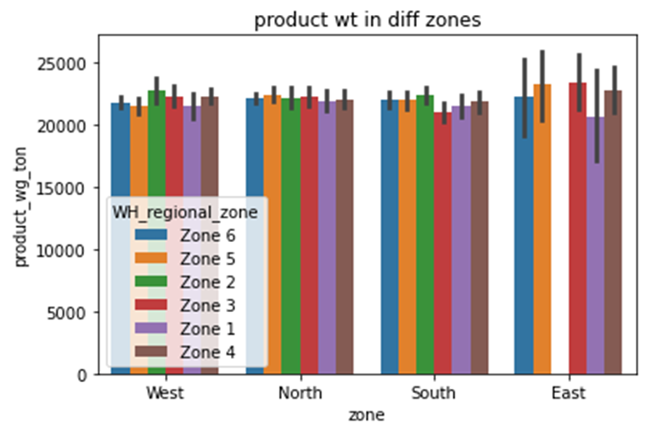
4 | Feature column: 'zone' vs Target column: ‘Product_wg_ton‘.
H0 | Product_wg_ton is independent on 'zone'
H1 | Product_wg_ton is dependent on 'zone'
P value | p value is 0.814 . We accept H0 which is the null hypothesis.
In graph The product wt. is more at East zone and comparatively less at West. Also wt. at regional zones also changes and little more at East.
but hypothesis shows no dependency.M1 suggests less dependency.

Slide 6
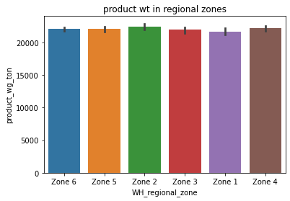
5 | Feature column: ‘'WH_regional_zone' ‘ vs Target column: ‘Product_wg_ton‘.
H0 | Product_wg_ton is independent on 'WH_regional_zone'
H1 | Product_wg_ton is dependent on 'WH_regional_zone'
P value | p value is 0.907 More than 0.05 .Accept null hyp..
Hypothesis shows no relation between them, but graph shows small changes with wh regional zones.Same inferences fom M1

Slide 7
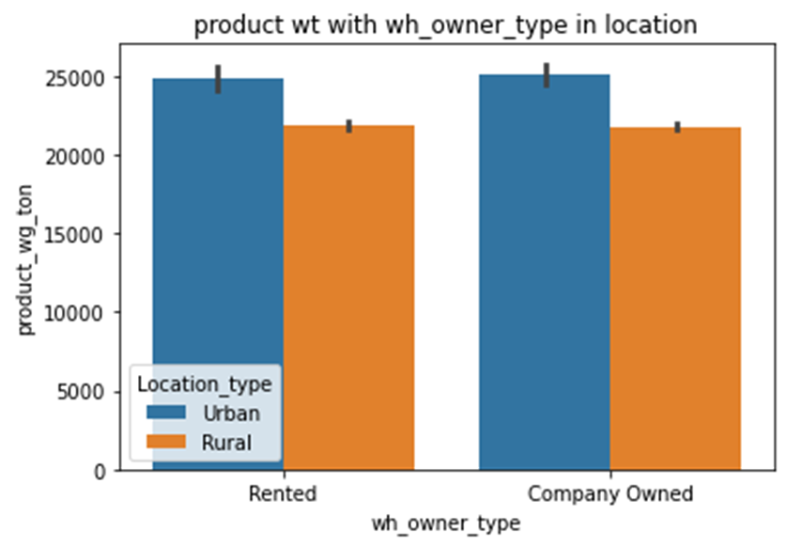
6 | Feature column: 'wh_owner_type' vs Target column: ‘Product_wg_ton‘.
H0 | Product_wg_ton is independent on 'wh_owner_type'
H1 | Product_wg_ton is dependent on 'wh_owner_type'
P value | p value is 0.423 . We accept null hypothesis.
Through graph and hypothesis we can say both columns are independent. In the graph here rented or owned type have almost same distribution on product wt. & therefore not affecting ,as mentioned in M1.

Slide 8
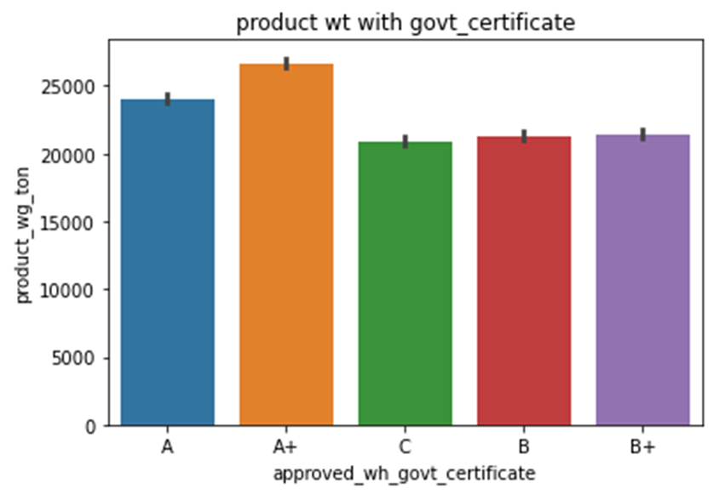
7 | Feature column: 'approved_wh_govt_certificate' vs Target column: ‘Product_wg_ton‘.
H0 | Product_wg_ton is independent on 'approved_wh_govt_certificate'
H1 | Product_wg_ton is dependent on 'approved_wh_govt_certificate'
P value | p value is 1.2193110659715722e-94 . We accept alternate hypothesis.
Here from hypothesis as well as from graph We can see A and A+ certified warehouses have more production and remaining follows the same .So this column is correlated to our target column. Same inferences in M1also.

Slide 9
LET’S LOOK INTO NUMERICAL COLUMNS

Slide 10
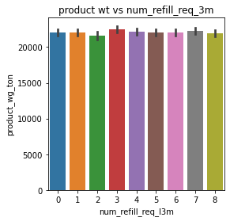
8 | Feature column: 'num_refill_req_3m' vs Target column: ‘Product_wg_ton‘.
H0 | Product_wg_ton is independent on 'num_refill_req_l3m'
H1 | Product_wg_ton is dependent on 'num_refill_req_l3m'
P value | p value is 0.919 . We accept null hypothesis.
Refill request has no dependency on product wt,since at maximum and minimum requests product wt. is same. This is completely against our observation in M1.

Slide 11
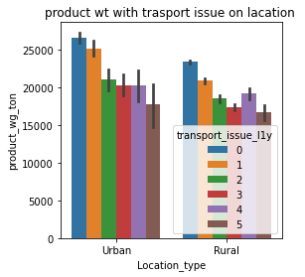
9 | Feature column: 'transport_issue_1y‘’ vs Target column: ‘Product_wg_ton‘.
H0 | Product_wg_ton is independent on 'transport_issue_l1y'
H1 | Product_wg_ton is dependent on 'transport_issue_l1y'
P value | p value is 3.9426614757382027e-153 . We accept alternate hypothesis.
Hypothesis & graph shows there is a significant correlation between both columns because infrastructure development affects the production and sales in a better way. Same as M1

Slide 12
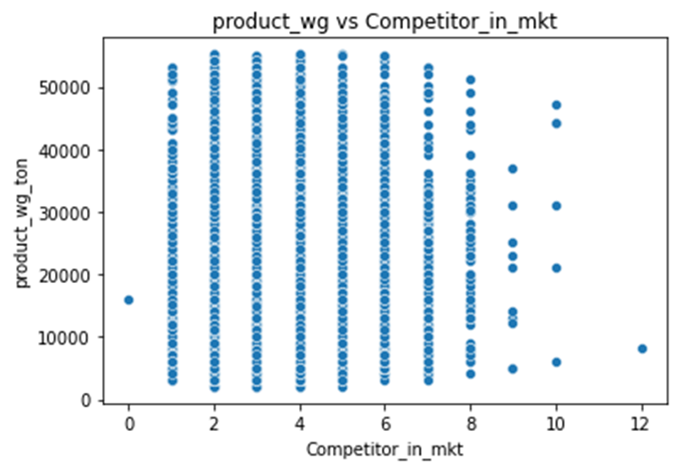
10 | Feature column: 'Competitor_in_mkt‘ vs Target column: ‘Product_wg_ton‘.
H0 | Product_wg_ton is independent on ‘ Competitor_in_mkt'
H1 | Product_wg_ton is dependent on 'Competitor_in_mkt'
P value | p value is 0.278 . We accept null hypothesis.
Through hypothesis we can find no significane bet columns.
Graph also shows the same. Slight difference from M1.

Slide 13
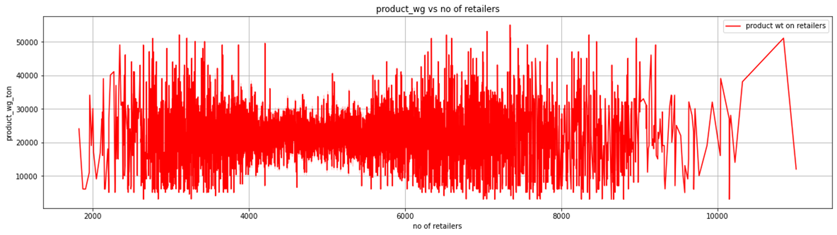
11 | Feature column: 'retail_shop_num' vs Target column: ‘Product_wg_ton‘.
HO | Product_wg_ton is independent on 'retail_shop_num'
H1 | Product_wg_ton is dependent on 'retail_shop_num'
P value | p value is 0.312 . We accept null hypothesis.
Hypothesis says both columns are independent .
By inferring this graph we can say there is some increase and decrease in production with increase in retailers and after a particular range say 10000 ,the density of retailers are few.
All these shows the product wt. is less depend with retailers. Same inferences we have made in M1.

Slide 14
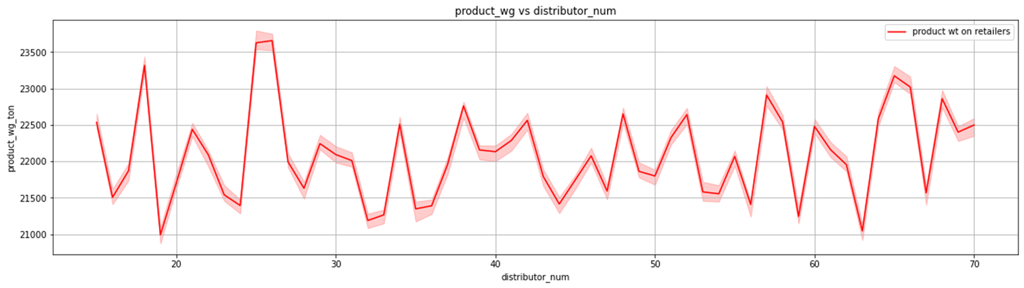
12 | Feature column: 'distributor_num' vs Target column: ‘Product_wg_ton‘.
H0 | Product_wg_ton is independent on 'distributor_num'
H1 | Product_wg_ton is dependent on 'distributor_num'
P value | p value is 0. 444 . We accept null hypothesis.
Hypothetically it says no dependency between columns which is almost same as graph.
The no. of distributers should be less than the half of retailers for a profitable supply chain. This is followed here ,and from the line plot we can inferred that there is less relation bet distributors and production of the goods which is also inferred fromM1.

Slide 15
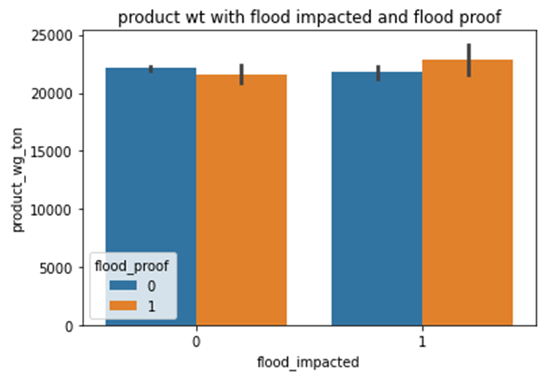
13 | Feature column: 'flood_impacted‘ & 'flood_proof' Vs ‘Product_wg_ton‘.
H0 | Product_wg_ton is independent on 'flood_impacted‘ & 'flood_proof'
H1 | Product_wg_ton is dependent on 'flood_impacted‘ & 'flood_proof'
P value | p value is 0.451 for flood impacted and 0.595 for floodproof . We accept H0.
Both methods gives the same inferences.
As suggested as M1,both flood impacted and flood proof have very less significance to our target column. Also we can see flood proof area highly affected the flood, therefore can ignore flood proof.

Slide 16
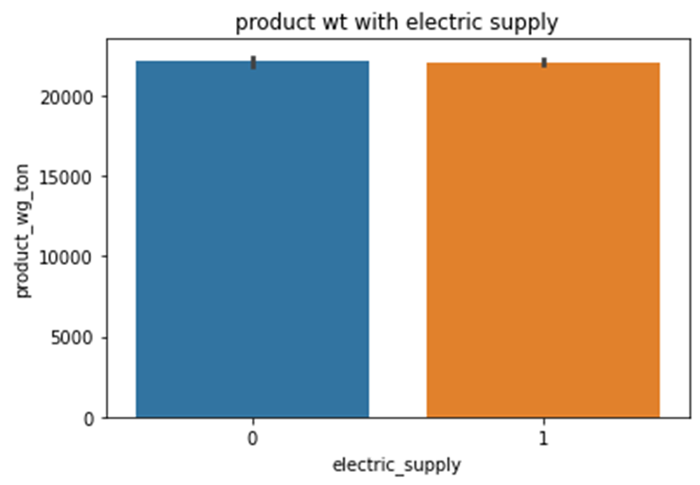
14 | Feature column: 'electric_supply‘ vs Target column: ‘Product_wg_ton‘.
H0 | Product_wg_ton is independent on 'electric_supply'
H1 | Product_wg_ton is dependent on 'electric_supply'
P value | p value is 0.914 . We accept null hypothesis.
Both methods gives the same inferences.that is no dependency which is opposite to our assumption in M1.

Slide 17
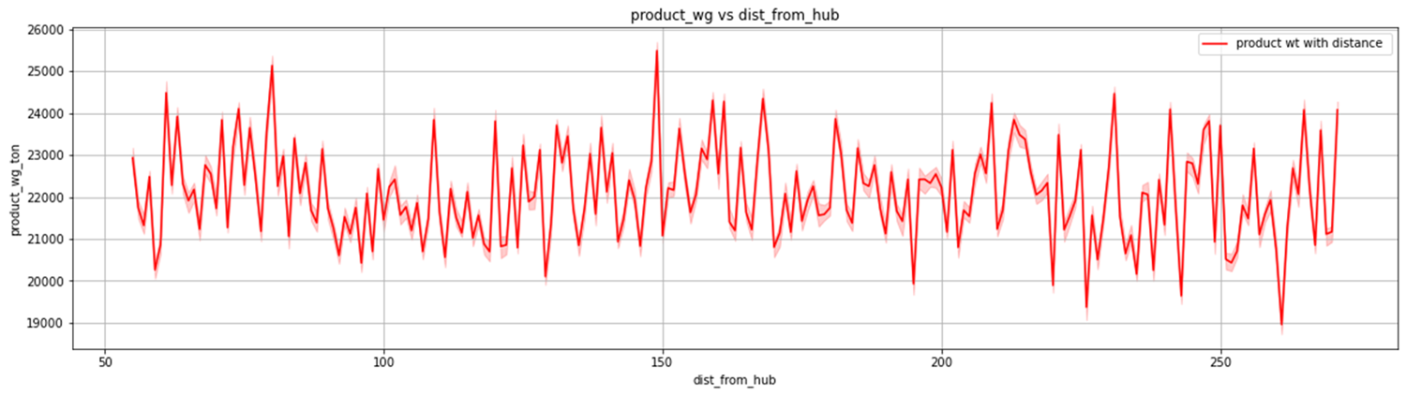
15 | Feature column: 'dist_from_hub‘ vs Target column: ‘Product_wg_ton‘.
H0 | Product_wg_ton is independent on 'dist_from_hub'
H1 | Product_wg_ton is dependent on 'dist_from_hub'
P value | p value is 0.368 . We accept null hypothesis.
Here both from hypothesis and graph we can inferred that the distance of hub from warehouse is not a matter of production weight and this is slightly different from observation from M1.

Slide 18
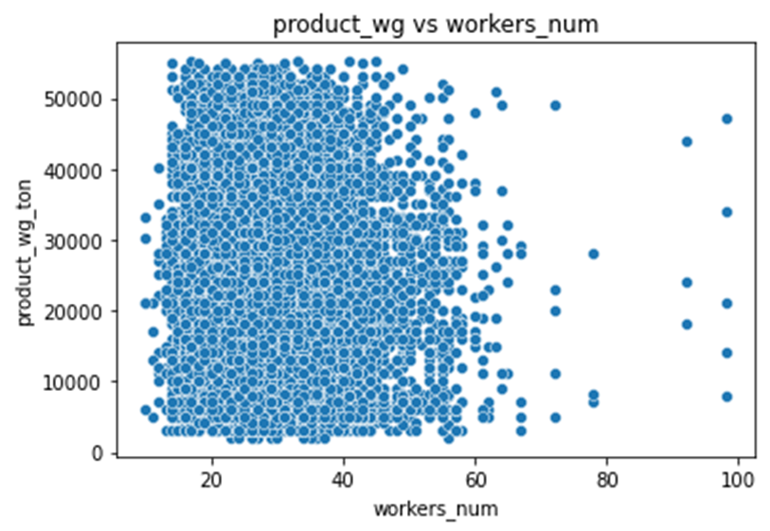
16 | Feature column: 'workers_num' vs Target column: ‘Product_wg_ton‘.
H0 | Product_wg_ton is independent on 'workers_num'
H1 | Product_wg_ton is dependent on 'workers_num'
P value | p value is 0.255 . We accept null hypothesis.
Both methods gives almost same suggestions.That is less dependencies which is different from M1.

Slide 19
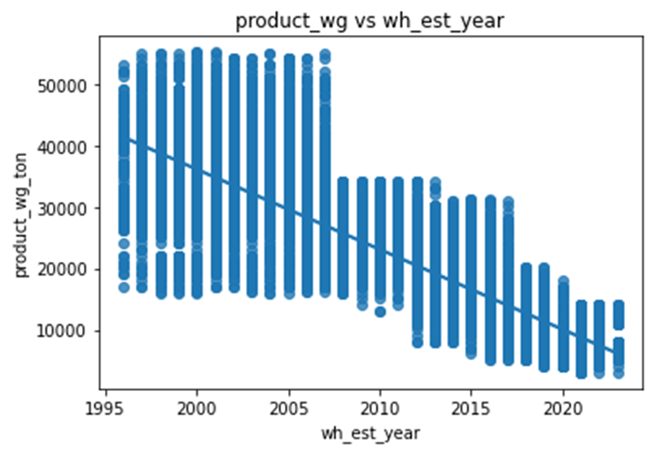
17 | Feature column: 'wh_est_year‘ vs Target column: ‘Product_wg_ton‘.
H0 | Product_wg_ton is independent on 'wh_est_year'
H1 | Product_wg_ton is dependent on 'wh_est_year'
P value | p value is 0.0 . We accept Alternate Hypothesis
Hypothetically and graphically we can say wh estimated year is correlated with product wt.
With time any business can be develop or drop and only those companies who can give a satisfactory and quality products to the customers can grow and withstand in that type of business .So with this graph we can infer that trust and sales can increase with years of experience and we didn’t infer this in our M1 since it has half of null values.

Slide 20
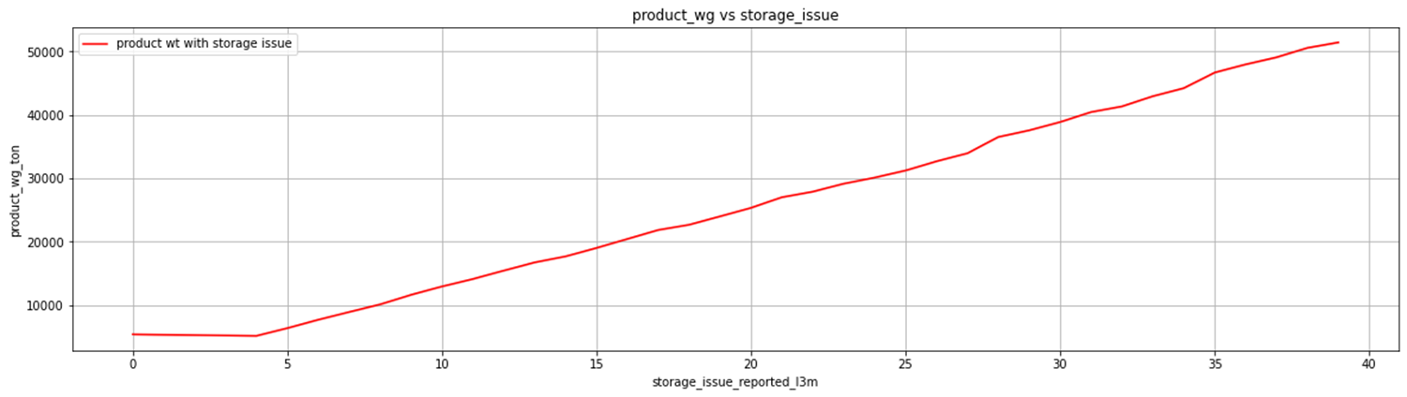
18 | Feature column: 'storage_issue_reported_l3m' Vs ‘Product_wg_ton‘.
H0 | Product_wg_ton is independent on 'storage_issue_reported_l3m'
H1 | Product_wg_ton is dependent on 'storage_issue_reported_l3m'
P value | p value is 0.0 . We accept Alternate hypothesis.
Both method gives the same inferences.
With increasing issues in storage here we can see that product weight increases highly. This is extremely opposite of the suggestion in M1.

Slide 21
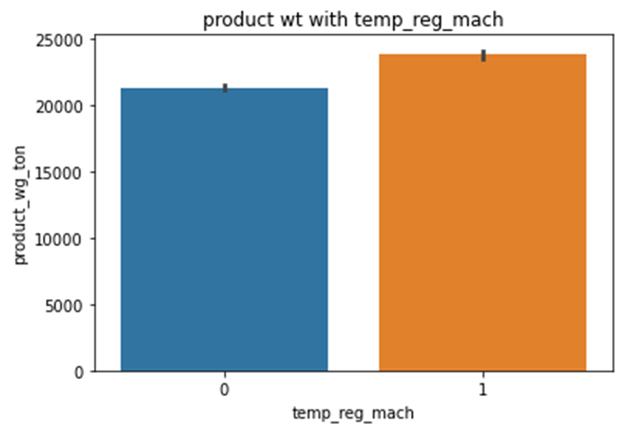
19 | Feature column: 'temp_reg_mach‘ Vs Target column: ‘Product_wg_ton‘.
H0 | Product_wg_ton is independent on 'temp_reg_mach'
H1 | Product_wg_ton is dependent on 'temp_reg_mach'
P value | p value is 7.76815612352695e-49 . We accept alternate hypothesis.
Hypothesis & graph shows Temperature regulatory machines are correlated with the production weight . This observation is same as M1.

Slide 22
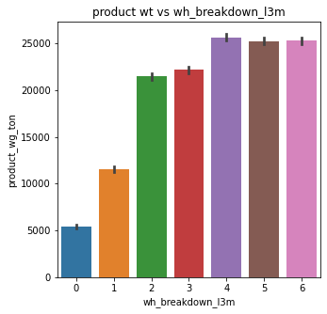
20 | Feature column: 'wh_breakdown_3m‘ Vs Target column: ‘Product_wg_ton‘.
H0 | Product_wg_ton is independent on 'wh_breakdown_l3m'
H1 | Product_wg_ton is dependent on 'wh_breakdown_l3m'
P value | p value is 0.0 . We accept Alternate hypothesis.
Hypothesis says they are highly correlated, and from this graph with increases in breakdown product wt. increases and with an inverse relationship This graph finding is against our M1.

Slide 23
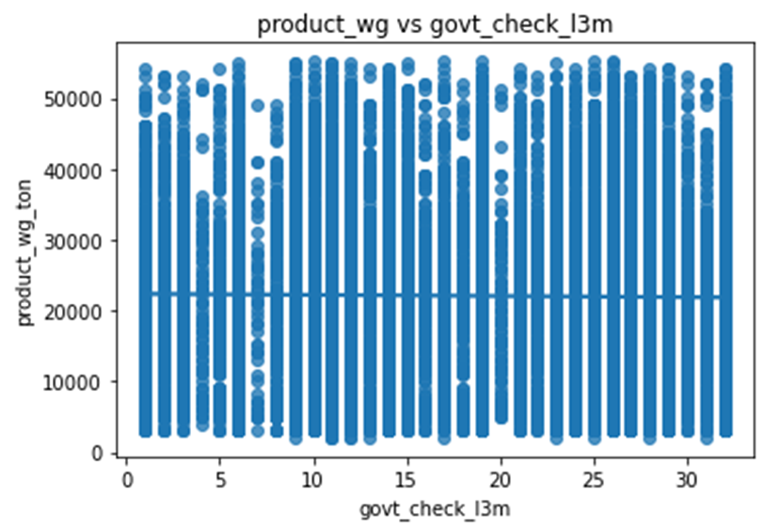
21 | Feature column: 'govt_check_3m' Vs Target column: ‘Product_wg_ton‘.
H0 | Product_wg_ton is independent on 'govt_check_l3m'
H1 | Product_wg_ton is dependent on 'govt_check_l3m'
P value | p value is 0.074 slightly more than 0.05 . We accept null hypothesis.
Both methods says no correlation.
In graph we can see even at max check the production is maximum. This observation is almost same as our M1 findings.

Slide 24
THANK YOU

